Slide 1
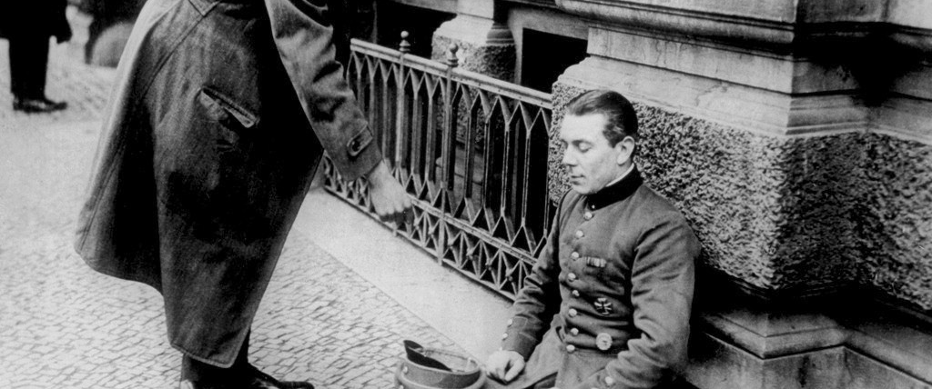
The Weimar Republic and its political faults
By Ahmed and Lisa

Slide 2
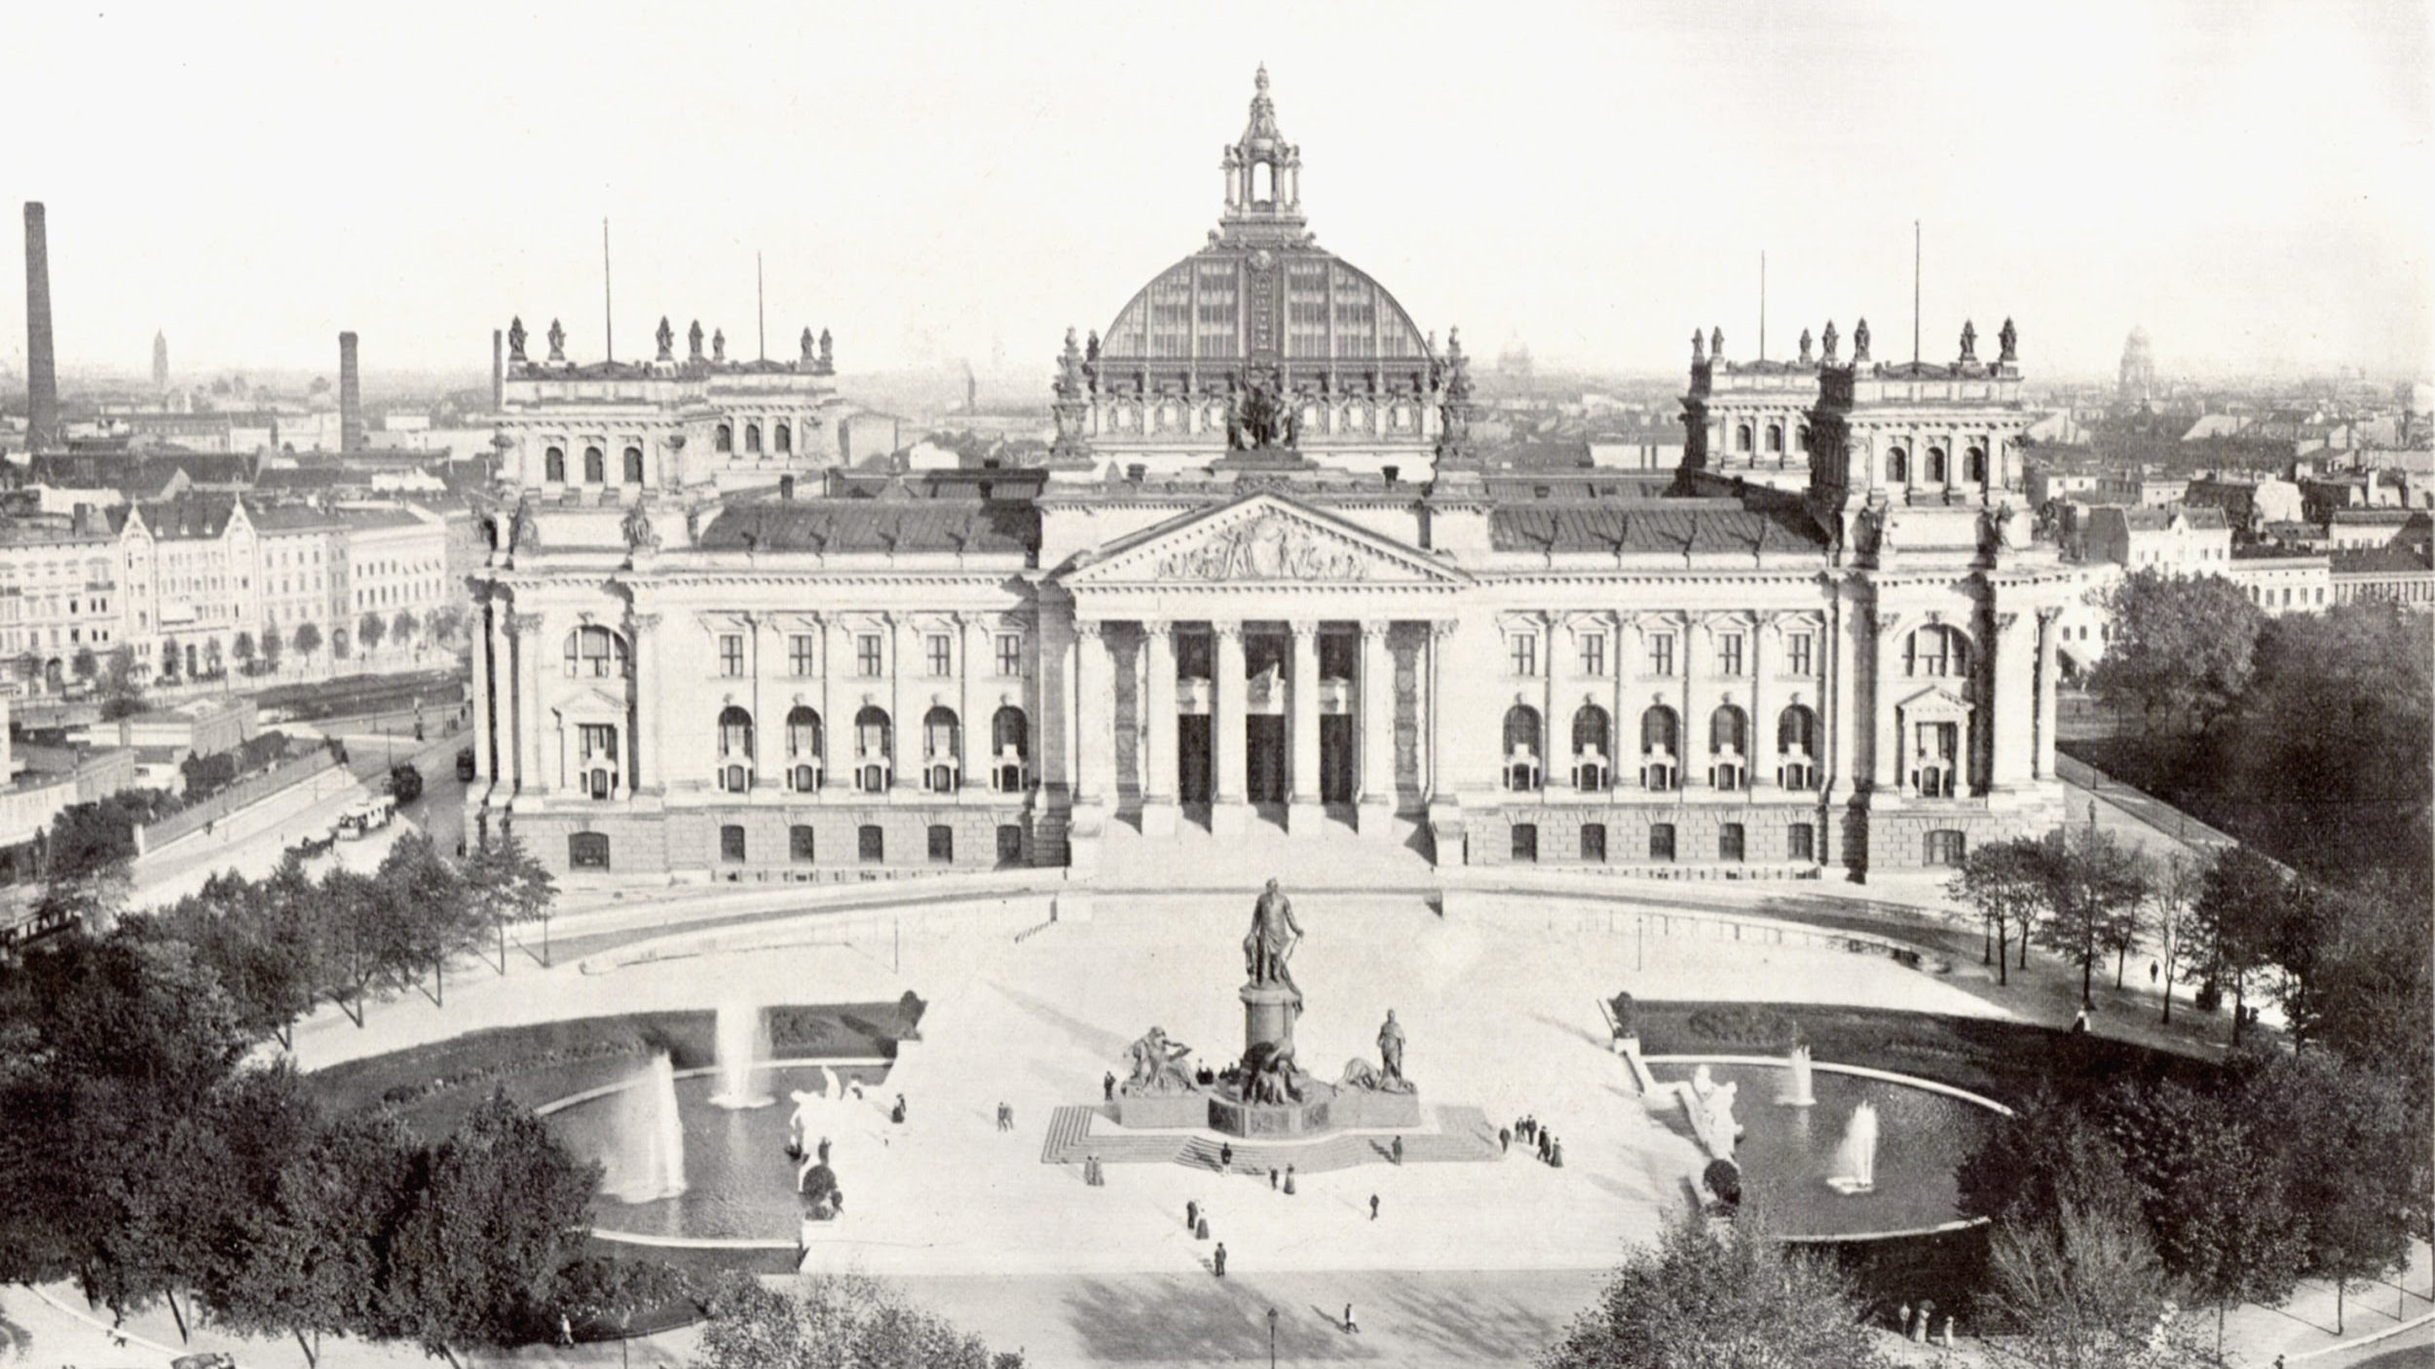
The Weimar Republic
When the Weimar Republic finally became the new government after the Kaiser was abdicated, they introduced new systems.

Slide 3
The Weimar constitution
.A president and a chancellor both held most of the power instead of a single kaiser
.Laws had to be passed by the Reichstag
.Proportional representation in the Reichstag
.Article 48, in an emergency the president could pass laws without the Reichstag approval
.State governments remained but had limited power
.All adult men and women had the vote

Slide 4
The people’s thoughts
Not everyone agreed with this new government. They were blamed for Germany’s downfall when they signed the treaty of Versailles in 1919, when in all reality they didn’t have much of a choice.
Though some people put the blame of the Kaiser for guaranteeing that they were winning the war when in fact, they were not.
Some liked the new democratic system while others didn’t. Some wished for communism while others wished for fascism.
The people had mixed feelings.

Slide 5
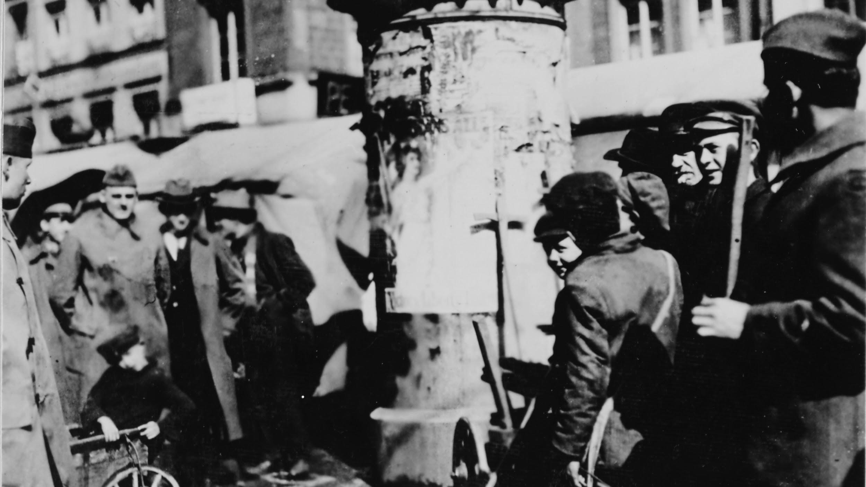
Proportional representation
The weimar republic had a parliament system for votes, this parliament was referred to as Reichstag. To decide which parties would be involved in said parliament, they would let the public vote, so that everyone could be represented. The amount of votes that a party got determined the amount of seats that they would receive in the parliament.

Slide 6
The good and the bad
Positives
.A variety of groups were represented
Negatives
.extremist groups could be represented
.Coalitions needed to be formed for laws to pass
.German people had to adapt from a Monarchy to a presidential system

Slide 7
Extremist Groups
Germany's loss in the First World War resulted in a chaotic situation, with multiple far-left and far-right organisations attempting to seize power. Both the far left and the far right organised their own militias, and carried out assassinations. For example, the Foreign Minister Walther Rathenau was assassinated in 1922 by a far-right group. Members of the Communist Party Of Germany assassinated police captainsPaul Anlauf and Franz Lenck in Berlin in 1931.

Slide 8
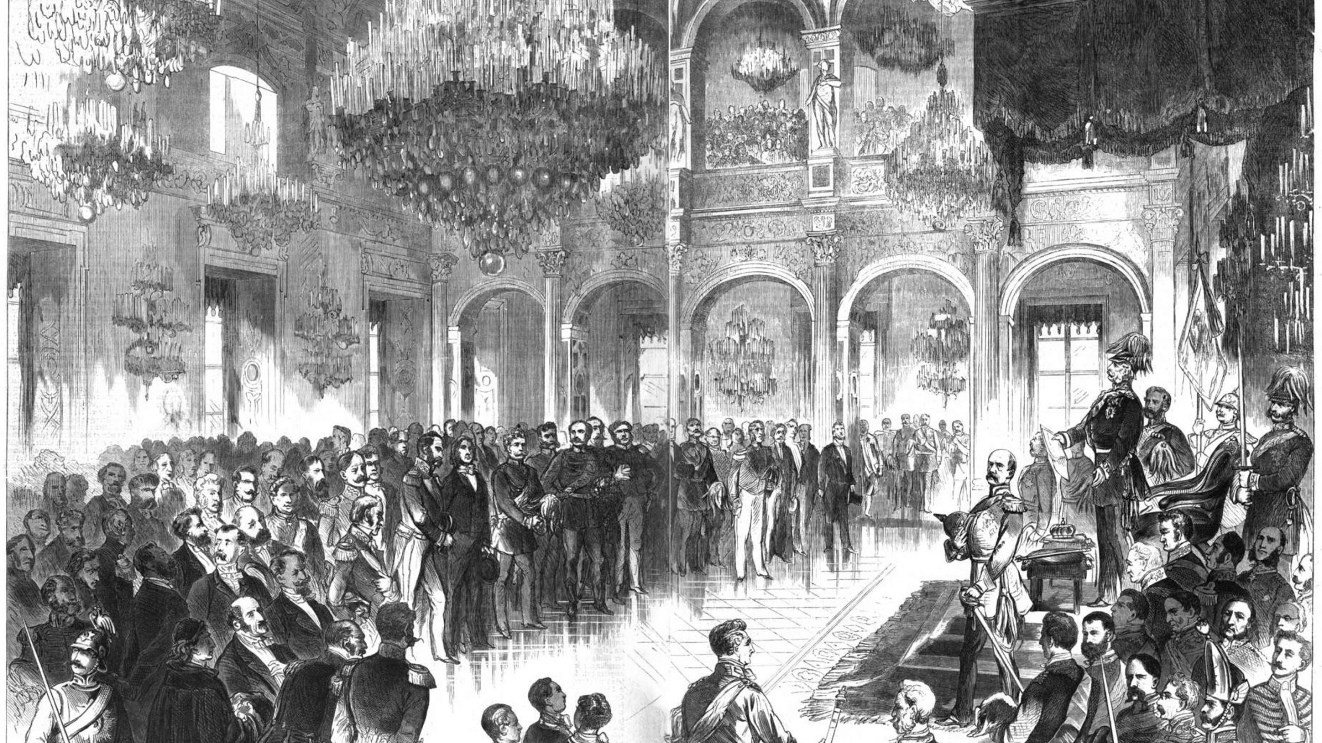
Coalitions
Many small parties wanted certain laws to pass, but the problem was that they often didn’t have enough votes to do so. Therefore, the solution was coalitions.
Coalitions often broke down, this made the Reichstag as well as the government unstable. Coalitions were the cause of many uneffective short term governments.

