Slide 1
WW1:The aftermath

Slide 2
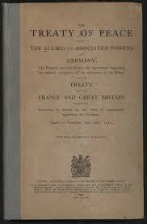
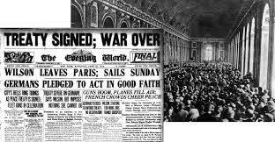
The Treaty of Versailles
Reparations
Loss of citizens loyalty and trust
No money for damage repair

Slide 3
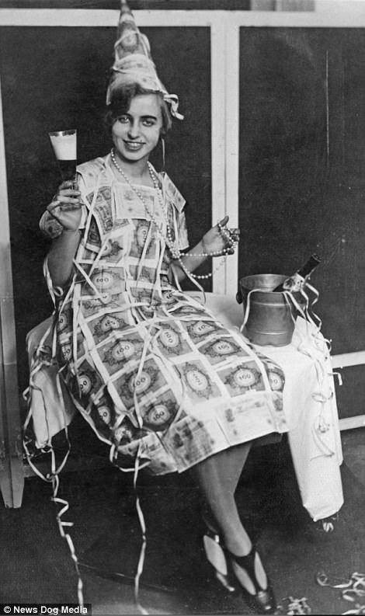
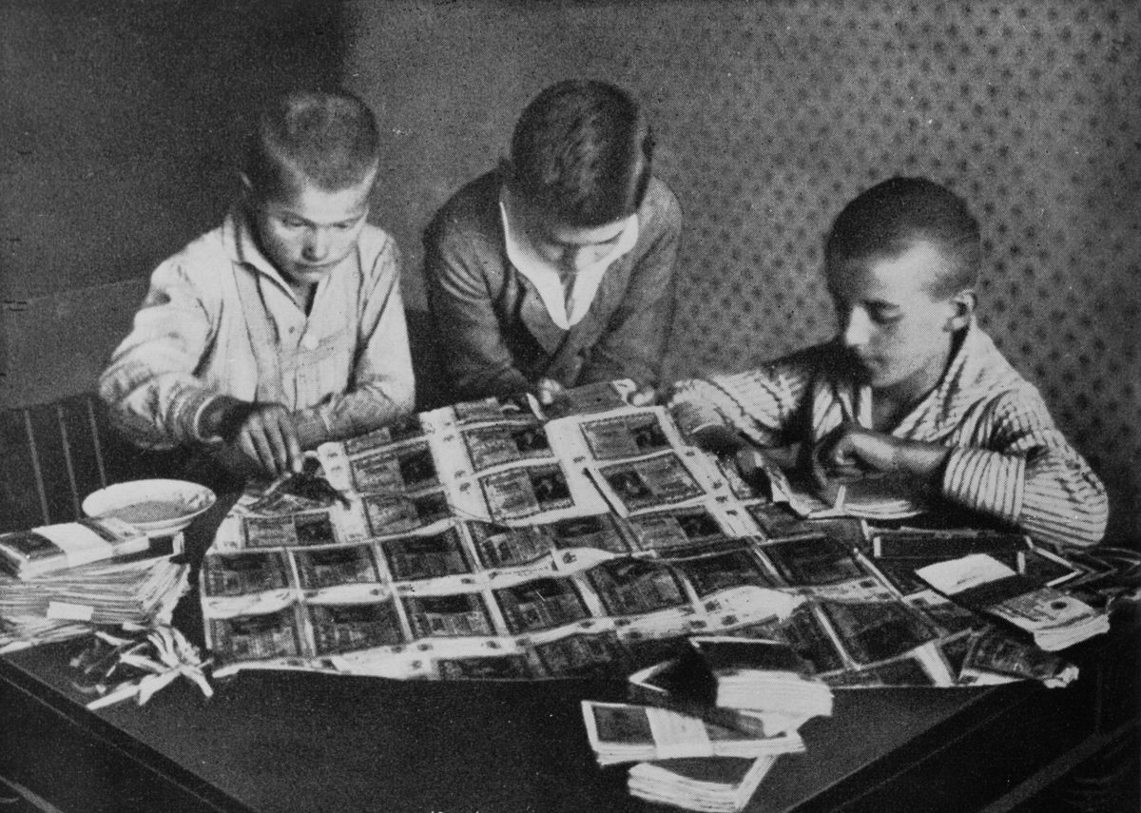
Money
Germany spent most of their money on their army
They had to pay off debts to numerous countries leaving no money for them and they eventually had no money to pay the debts leading to their invasion and exploitation of raw assets

Slide 4
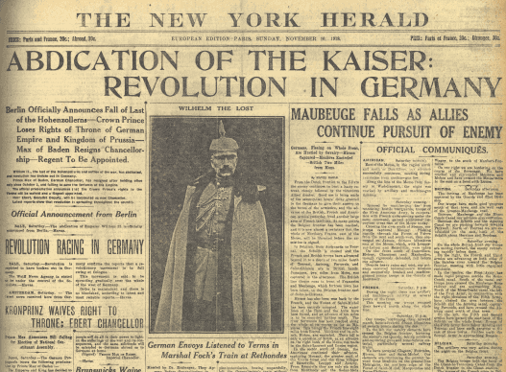
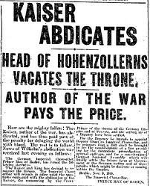
New Government
The only constant in the German public’s lives was the Kaiser
When the Kaiser abdicated, people find it hard to accept the Weimar government

Slide 5
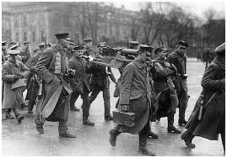
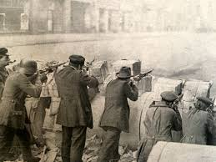
Rebellions
The Weimar government seemed weak because:
After the war ended, it failed to assume full control and loyalty of the German citezens
When the rebellion of 1918-19 occurred, they had to call on their ex-soldiers to stop it
This made them seem incapable of running a country, which eventually led to their downfall

Slide 6
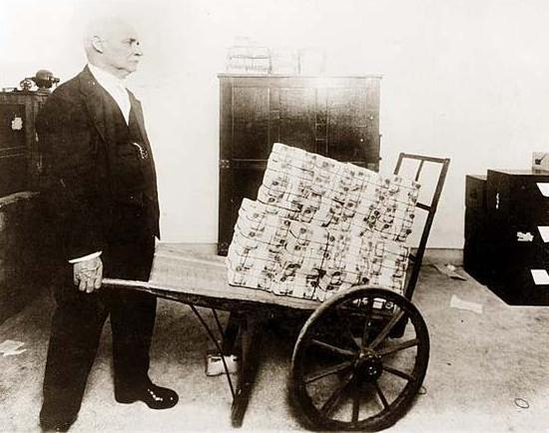
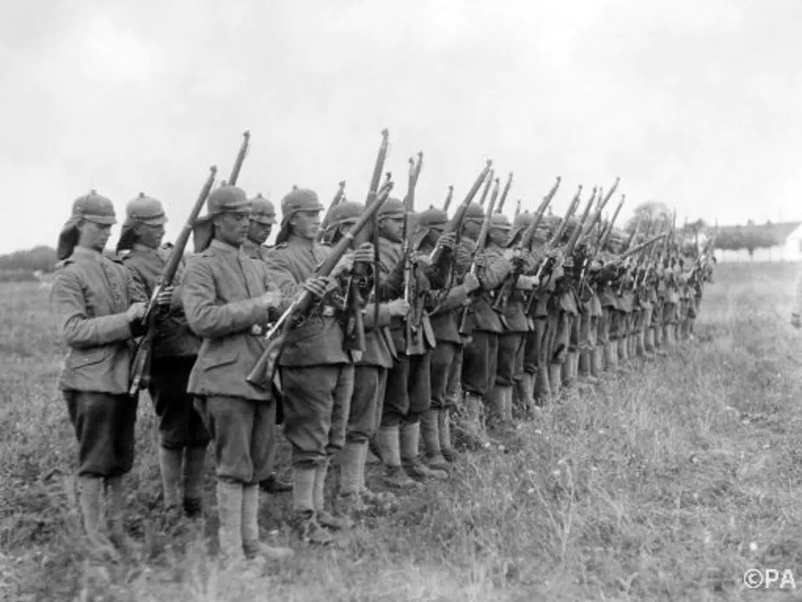
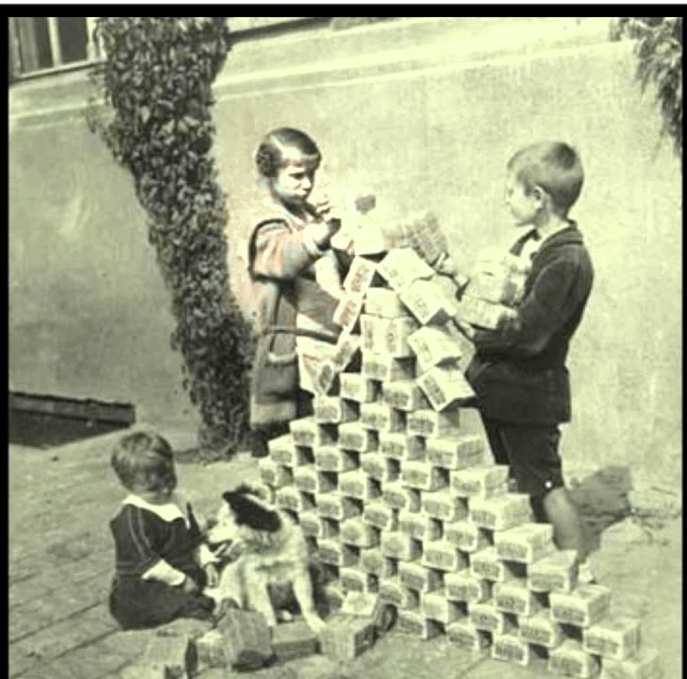
In Conclusion...

